Slide 1
Chapter 5: Availability

Slide 2
Chapter Outline
What is Availability?
Availability General Scenario
Tactics for Availability
A Design Checklist for Availability
Summary

Slide 3
What is Availability?
Availability refers to a property of software that it is there and ready to carry out its task when you need it to be.
This is a broad perspective and encompasses what is normally called reliability.
Availability builds on reliability by adding the notion of recovery (repair).
Fundamentally, availability is about minimizing service outage time by mitigating faults.

Slide 4
Availability General Scenario
Portion of Scenario | Possible Values
Source | Internal/external: people, hardware, software, physical infrastructure, physical environment
Stimulus | Fault: omission, crash, incorrect timing, incorrect response
Artifact | System’s processors, communication channels, persistent storage, processes
Environment | Normal operation, startup, shutdown, repair mode, degraded operation, overloaded operation
Response | Prevent the fault from becoming a failure Detect the fault: log the fault notify appropriate entities (people or systems) Recover from the fault disable source of events causing the fault be temporarily unavailable while repair is being effected fix or mask the fault/failure or contain the damage it causes operate in a degraded mode while repair is being effected
Response Measure | Time or time interval when the system must be available Availability percentage (e.g. 99.999%) Time to detect the fault Time to repair the fault Time or time interval in which system can be in degraded mode Proportion (e.g., 99%) or rate (e.g., up to 100 per second) of a certain class of faults that the system prevents, or handles without failing

Slide 5
Sample Concrete Availability Scenario
The heartbeat monitor determines that the server is nonresponsive during normal operations. The system informs the operator and continues to operate with no downtime.

Slide 6
Goal of Availability Tactics
A failure occurs when the system no longer delivers a service consistent with its specification
  this failure is observable by the system’s actors.
A fault (or combination of faults) has the potential to cause a failure.
Availability tactics enable a system to endure faults so that services remain compliant with their specifications.
The tactics keep faults from becoming failures or at least bound the effects of the fault and make repair possible.

Slide 7
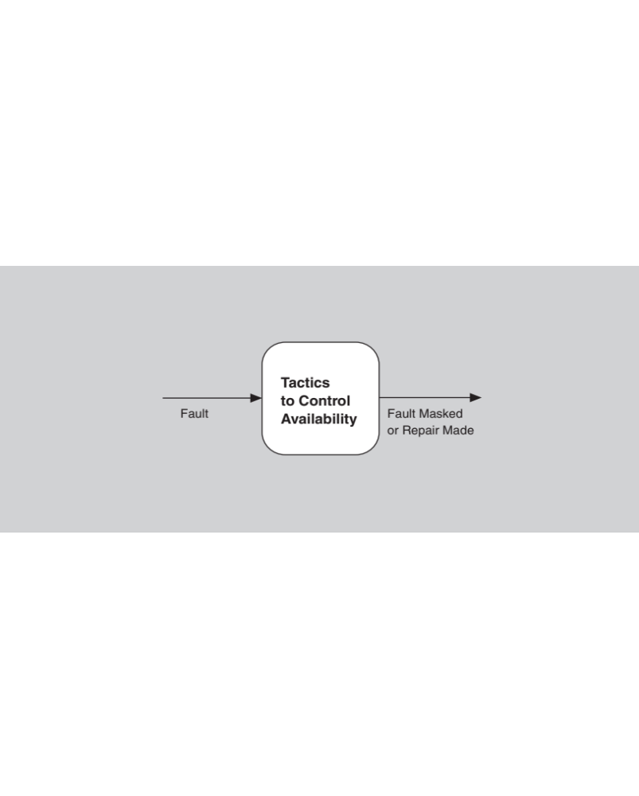
Goal of Availability Tactics

Slide 8
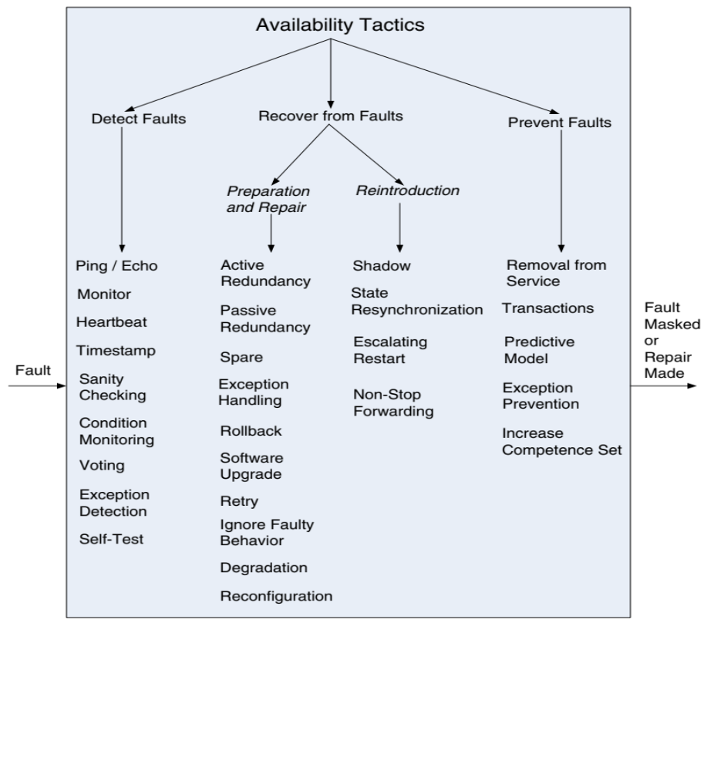
Availability Tactics

Slide 9
Detect Faults
Ping/echo: asynchronous request/response message pair exchanged between nodes, used to determine reachability and the round-trip delay through the associated network path.
Monitor: a component used to monitor the state of health of other parts of the system. A system monitor can detect failure or congestion in the network or other shared resources, such as from a denial-of-service attack.
Heartbeat: a periodic message exchange between a system monitor and a process being monitored.

Slide 10
Detect Faults
Timestamp: used to detect incorrect sequences of events, primarily in distributed message-passing systems.
Sanity Checking: checks the validity or reasonableness of a component’s operations or outputs; typically based on a knowledge of the internal design, the state of the system, or the nature of the information under scrutiny.
Condition Monitoring: checking conditions in a process or device, or validating assumptions made during the design.

Slide 11
Detect Faults
Voting: to check that replicated components are producing the same results. Comes in various flavors: replication, functional redundancy, analytic redundancy.
Exception Detection: detection of a system condition that alters the normal flow of execution, e.g. system exception, parameter fence, parameter typing, timeout.
Self-test: procedure for a component to test itself for correct operation.

Slide 12
Recover from Faults
(Preparation & Repair)
Active Redundancy (hot spare): all nodes in a protection group receive and process identical inputs in parallel, allowing redundant spare(s) to maintain synchronous state with the active node(s).
  A protection group is a group of nodes where one or more nodes are “active,” with the remainder serving as redundant spares.
Passive Redundancy (warm spare): only the active members of the protection group process input traffic; one of their duties is to provide the redundant spare(s) with periodic state updates.
Spare (cold spare): redundant spares of a protection group remain out of service until a fail-over occurs, at which point a power-on-reset procedure is initiated on the redundant spare prior to its being placed in service.

Slide 13
Recover from Faults
(Preparation & Repair)
Exception Handling: dealing with the exception by reporting it or handling it, potentially masking the fault by correcting the cause of the exception and retrying.
Rollback: revert to a previous known good state, referred to as the “rollback line”.
Software Upgrade: in-service upgrades to executable code images in a non-service-affecting manner.

Slide 14
Recover from Faults
(Preparation & Repair)
Retry: where a failure is transient retrying the operation may lead to success.
Ignore Faulty Behavior: ignoring messages sent from a source when it is determined that those messages are spurious.
Degradation: maintains the most critical system functions in the presence of component failures, dropping less critical functions.
Reconfiguration: reassigning responsibilities to the resources left functioning, while maintaining as much functionality as possible.

Slide 15
Recover from Faults
(Reintroduction)
Shadow: operating a previously failed or in-service upgraded component in a “shadow mode” for a predefined time prior to reverting the component back to an active role.
State Resynchronization: partner to active redundancy and passive redundancy where state information is sent from active to standby components.
Escalating Restart: recover from faults by varying the granularity of the component(s) restarted and minimizing the level of service affected.
Non-stop Forwarding: functionality is split into supervisory and data. If a supervisor fails, a router continues forwarding packets along known routes while protocol information is recovered and validated.

Slide 16
Prevent Faults
Removal From Service: temporarily placing a system component in an out-of-service state for the purpose of mitigating potential system failures
Transactions: bundling state updates so that asynchronous messages exchanged between distributed components are atomic, consistent, isolated, and durable.
Predictive Model: monitor the state of health of a process to ensure that the system is operating within nominal parameters; take corrective action when conditions are detected that are predictive of likely future faults.

Slide 17
Prevent Faults
Exception Prevention: preventing system exceptions from occurring by masking a fault, or preventing it via smart pointers, abstract data types, wrappers.
Increase Competence Set: designing a component to handle more cases—faults—as part of its normal operation.

Slide 18
Summary
Availability refers to the ability of the system to be available for use when a fault occurs.
The fault must be recognized (or prevented) and then the system must respond.
The response will depend on the criticality of the application and the type of fault
  can range from “ignore it” to “keep on going as if it didn’t occur.”

Slide 19
Summary
Tactics for availability are categorized into detect faults, recover from faults and prevent faults.
Detection tactics depend on detecting signs of life from various components.
Recovery tactics are retrying an operation or maintaining redundant data or computations.
Prevention tactics depend on removing elements from service or limiting the scope of faults.
All availability tactics involve the coordination model.

